Slide 1

Charles Book club(CBC)
Team Members:
K. T. P. M Kariyawasam IT16063310
A. A. Arshad IT16032316
A. Arraamuthan IT16086326
S. I Krusanth IT16122338
Gowshalini Rajalingam IT16113800
S. Y. Senanayake IT16125308
L N kodithuwakku IT16038660

Slide 2
Introduction to Charles book club
The Charles Book Club (CBC) was established in December 1986.
CBC is strictly a distributor and does not publish any of the books that it sells.
CBC built and maintained a detailed database about its club members.

Slide 3
The Problem
The main goal of this study is to generate a suitable customer list which would positively impact the selling of specialty books.
CBC sent mailings to its club members containing its latest offerings to allow them to know their customers better and enable multiple targeted campaigns where each target audience would receive appropriate mailings .

Slide 4
two-step approach
For each new title,
Conduct a market test involving a random sample of customers from the database to enable analysis of customer response. The analysis would create and calibrate response models for the current book offerings.
Based on the response models, compute a score for each customer in the database.
Use this score and a cutoff value to extract a target customer list for direct mail promotion.

Slide 5
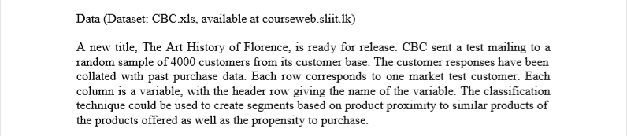
Art History of Florence
A new title, "The Art History of Florence", is ready for release.
CBC has sent a test mailing to a random sample of 4,000 customers from its customer base.
The customer responses have been collated with past purchase data.
Each row corresponds to one market test customer. Each column is a variable, with the header row giving the name of the variable.

Slide 6
Our Dataset
The dataset consists of 4000 samples with each record consisting of 24 features. Each feature is described below with their corresponding definition.
Seq# -Sequence number in the training data
ID# -Customer Identification number in test database
Gender -O=Male 1=Female
M –(Monetary)Total money spent on books
R –(Recency)Months since last purchase
F -(Frequency)Total number of purchases
FirstPurch- Months since first purchase
ChildBks- Number of purchases from the category: Child books
YouthBks- Number of purchases from the category: Youth books
CookBks- Number of purchases from the category: Cookbooks
DoItYBks- Number of purchases from the category: Do It Yourself books
RefBks- Number of purchases from the category: Reference books (Atlases,Encyclopedias, Dictionaries)
ArtBks- Number of purchases from the category: Art books

Slide 7
Continued..
GeoBks-Number of purchases from the category: Geography books
ItalCook- Number of purchases of book title: "Secrets of Italian Cooking"
ItalAtlas -Number of purchases of book title: "Historical Atlas of Italy"
ItalArt -Number of purchases of book title: "Italian Art"
Florence - =1 'The Art History of Florence" was bought, = 0 if not
Related purchase - Number of related books purchased
Mcode- Range corresponds to total money spent; 0-25=1, 26-50=2, 51-100=3, 101-200=4, 201+=5
Rcode- Range corresponds to recent purchase ;0-2=1, 3-6=2, 7-12=3, 13+=4
Fcode- Range corresponds to total number of purchases ;1=1, 2=2, 3+=3
Yes_Florence-bought_art_history_of_florence=1, else 0
No_Florence-bought_art_history_of_florence=0, else 1

Slide 8
Analysis
1
2
Descriptive Analysis
Predictive Analysis

Slide 9
1.Descriptive Analysis
To understand the customer base
The areas of descriptive analysis
Gender Analysis
Monetary VS Gender (Analyzing money spent on books )
Popularity of books
Most recent purchase data

Slide 10
Gender Analysis
As the gender is considered as a nominal data, and there is no order to the segments, pie chart and bar chart can be used to display different percentages representing male and female customers at CBC.
Females make up 70.45% of the customers whereas males make up only 29.55% of the total customers.
The total number of female customers is more than the total number of male customers

Slide 11
Monetary VS Gender
A typical customer spends $76.35 on Average to by books.
Female customers are spending more money to buy books at CBC.
Sum of M
Gender | Total
0 | 248033
1 | 584333
Grand Total | 832366
Avg | 208.0915

Slide 12
Popularity of books
Child and Cook books are most popular books among other books.
The popularity is approximately similar for Youth, DoItY, Ref, Art, Geo Books.
The popularity of ItalCook, ItalAtlas, ItalArt are less.
ChildBks | YouthBks | CookBks | DoItYBks | RefBks | ArtBks | GeogBks | ItalCook | ItalAtlas | ItalArt
2559 | 1219 | 2925 | 1403 | 1025 | 1156 | 1550 | 501 | 150 | 183

Slide 13
Most recent purchase data
By looking closely at the histogram of the recent purchase data, we can see that most customers at CBC purchased their latest books in more than 13 months since the previous purchases.
Customer Frequency is increasing with recency.
Rcode Range: 0-2=1, 3-6=2, 7-12=3, 13+=4
Rcode | Frequency
1 | 294
2 | 558
3 | 1322
4 | 1826

Slide 14
2.Predictive Analysis
To make prediction

Slide 15
Hint for the Analysis
The classification technique could be used to create segments based on product proximity to similar products of the products offered as well as the propensity to purchase.
RFM Segmentation

Slide 16
RFM Segmentation
The segmentation process in database marketing aims to partition customers in a list of prospects into homogenous groups (segments) that are similar with respect to buying behavior.
The homogeneity criterion we need for segmentation is propensity to purchase the offering. But since we cannot measure this attribute,

Slide 17
RFM Segmentation
R - Recency - time since last purchase
F - Frequency - the number of previous purchases from the company over a period
M - Monetary - the amount of money spent on the company's products over a period
The more products bought from the company in the past, and the more money spent in the past buying the company's products, the more likely is the customer to purchase the product offered.

Slide 18
Predictive analysis WorkFlow
Problem Identification
Preprocess Data and Segmentation
Select Best Model
Build Models
Prediction
Visualization
(Dash Board)

Slide 19
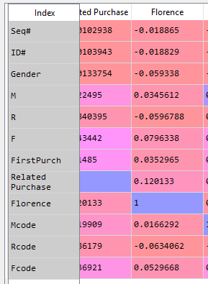
Data preprocessing
Removing records which have null values.(but no missing values found in CBC dataset)
Remove duplicate records
Transform all data into numerical values (int64)
* To pass categorical variables
Normalized data
Select attributes which should represent the model.
highly co- relevant attributes selected

Slide 20
Data segmentation
CBC Dataset
Training Dataset
Validation Dataset
Test Dataset
45%
35%
20%

Slide 21
Model selection
1
2
Based on Model Accuracy
Based on the Log Loss score

Slide 22
Log Loss score
Log loss, also called “logistic loss,” “logarithmic loss,” or “cross entropy” can be used as a measure for evaluating predicted probabilities.
Each predicted probability is compared to the actual class output value (0 or 1) and a score is calculated that penalizes the probability based on the distance from the expected value.
The penalty is logarithmic, offering a small score for small differences (0.1 or 0.2) and enormous score for a large difference (0.9 or 1.0).

Slide 23
1) Select model based on Accuracy and Log Loss score
We randomly selected seven models(7) which are suitable for classification problem.
Model | Accuracy score | Log loss score
LogisticRegression | 0.9035714285714286 | 2.885432116625744
GradientBoostingClassifier | 0.9035714285714286 | 0.3758663458725302
KNeighborsClassifier | 0.9035714285714286 | 2.918710097663723
GaussianNB | 0.09642857142857143 | 31.62098182098807
svm | 0.9035714285714286 | 0.38561602407570225
DecisionTree | 0.555 | 16.05223875713422
RandomForestClassifier | 0.9035714285714286 | 0.547846218533718

Slide 24
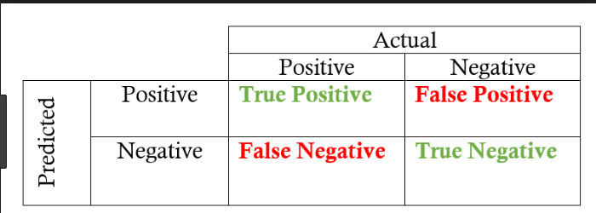
Predict results
As we were asked to compute a score for each customer and use this score and a cutoff value to extract a target customer list for direct mail promotion we used probability scoring technique to score each customer.
The optimal cut off would be where tpr is high and fpr is low
tpr - (1-fpr) is zero or near to zero is the optimal cut off point

Slide 25
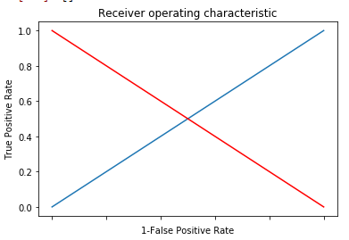

Optimal Cut off value
The optimal cut off value is found where the true positive rate is high and false positive rate is low. The cut off value is 0.300772

Slide 26
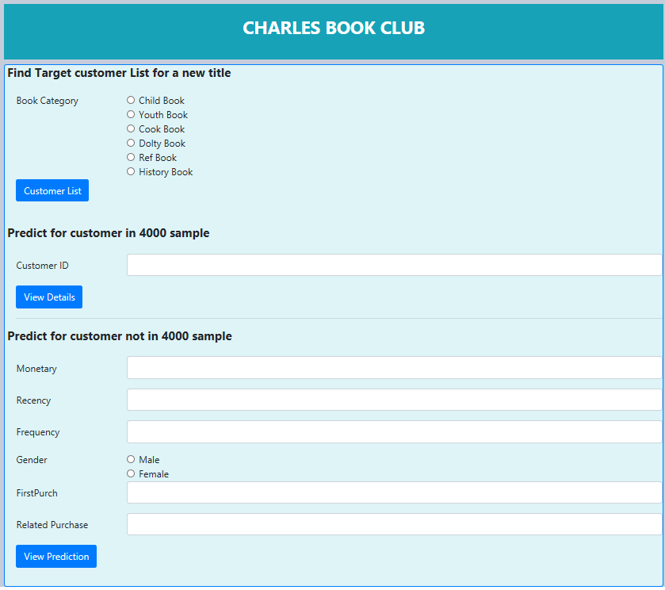
Visualization
We have created the dashboard which can predict
For a given book category of a new title List of target users
For a given customer from csv file the predicted results whether the customer will by the offered book or not
For customer out of the sample prediction.
We use python flask to create the dashboard
index page

Slide 27
Thank You

